Slide 1
MOOn-Viz
Learning User Preference in the Multi-Objective
Optimization of Network Visualization
Daniel Cohen | Danielle Nguyen Sarah Shugars | Xindi Wang

Slide 2
Multi-Objective Optimization
Multiple objectives, Want to optimize over those objectives
Problem: Conflicts between feature optimization
Set of optimal solutions: Pareto front

Slide 3
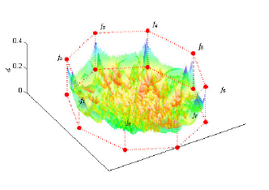
Multi-Objective Optimization
3D-RadVis visualization from Ibrahim, et al. (2016 )

Slide 4
Multi-Objective Optimization
What to do?
Reduce solution space...
Reduce objectives
Find ranking of solutions
Learn user preference

Slide 5
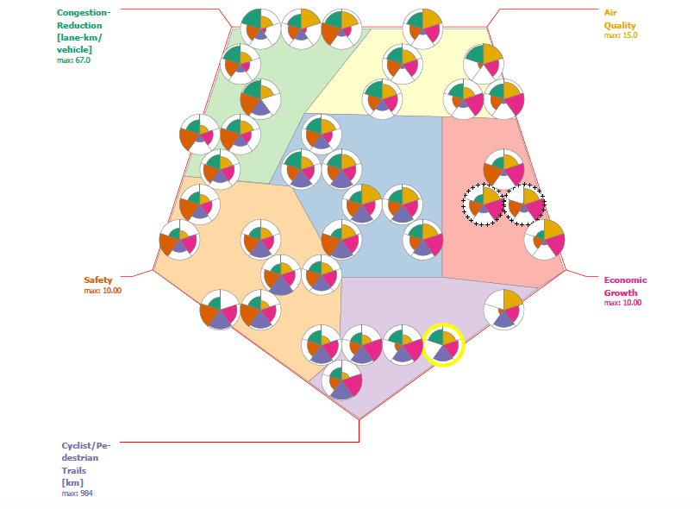
Multi-Objective Optimization
SOMMOS visualization from Chen et al. (2013 )

Slide 6
Multi-Objective Optimization
Learn user preference
HOW?

Slide 7
Genetic Algorithms
“the user and computer to interactively work together in a new way to produce results that neither could easily produce alone.”
Sims (1991)

Slide 8
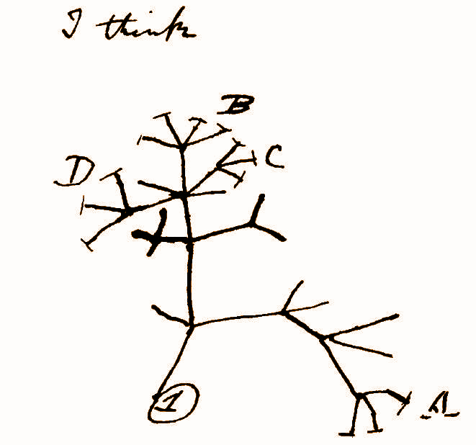
Genetic Algorithms
Evolve through variation and selection

Slide 9
Network Visualization
Multi-Objective Optimization

Slide 10
Network Visualization
What layout is best?

Slide 11
Network Visualization
Fundamentally a MOO problem:
A “good layout” can be measured by numerous graph readability metrics
Cannot simultaneously optimize all of them
User preference matters

Slide 12
Related Work
Genetic Algorithms & Graph Layout

Slide 13
Barbosa and Barreto (2001)
What layout is best?
* Where ‘best’ is judged by user preference

Slide 14
Proof of Concept
Barbosa and Barreto (2001):
Show a user random layouts
Coordinates
Feature weights
User ranks layouts
Coevolution
Repeat

Slide 15
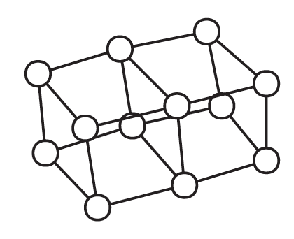
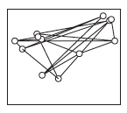
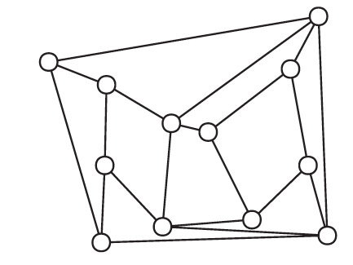
Proof of Concept
Barbosa and Barreto (2001)

Slide 16
do Nascimento and Eades (2002)
What layout is best*?
* Where ‘best’ is judged by user preference

Slide 17
User ‘hints’
do Nascimento and Eades (2002):
Give user a pseudo-optimized layout
User provides hints:
Select nodes whose layout should improve
Indicate relationship constraints
Evolve population of coordinates
Select new layouts by tournament
Repeat

Slide 18
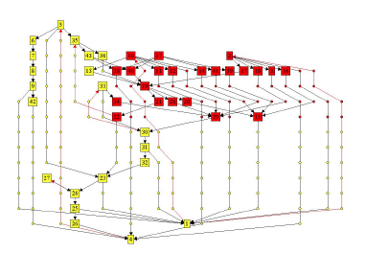
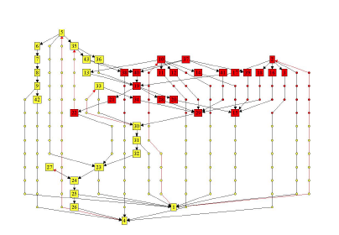
User ‘hints’
do Nascimento and Eades (2002)

Slide 19
User ‘hints’
do Nascimento and Eades (2002)

Slide 20
MOOn-Viz
Conceptual Overview

Slide 21
MOOn-Viz
What layout is best*?
* Where ‘best’ is judged by user preference

Slide 22
MOOn-Viz
What optimization of readability features is best*?
* Where ‘best’ is judged by user preference

Slide 23
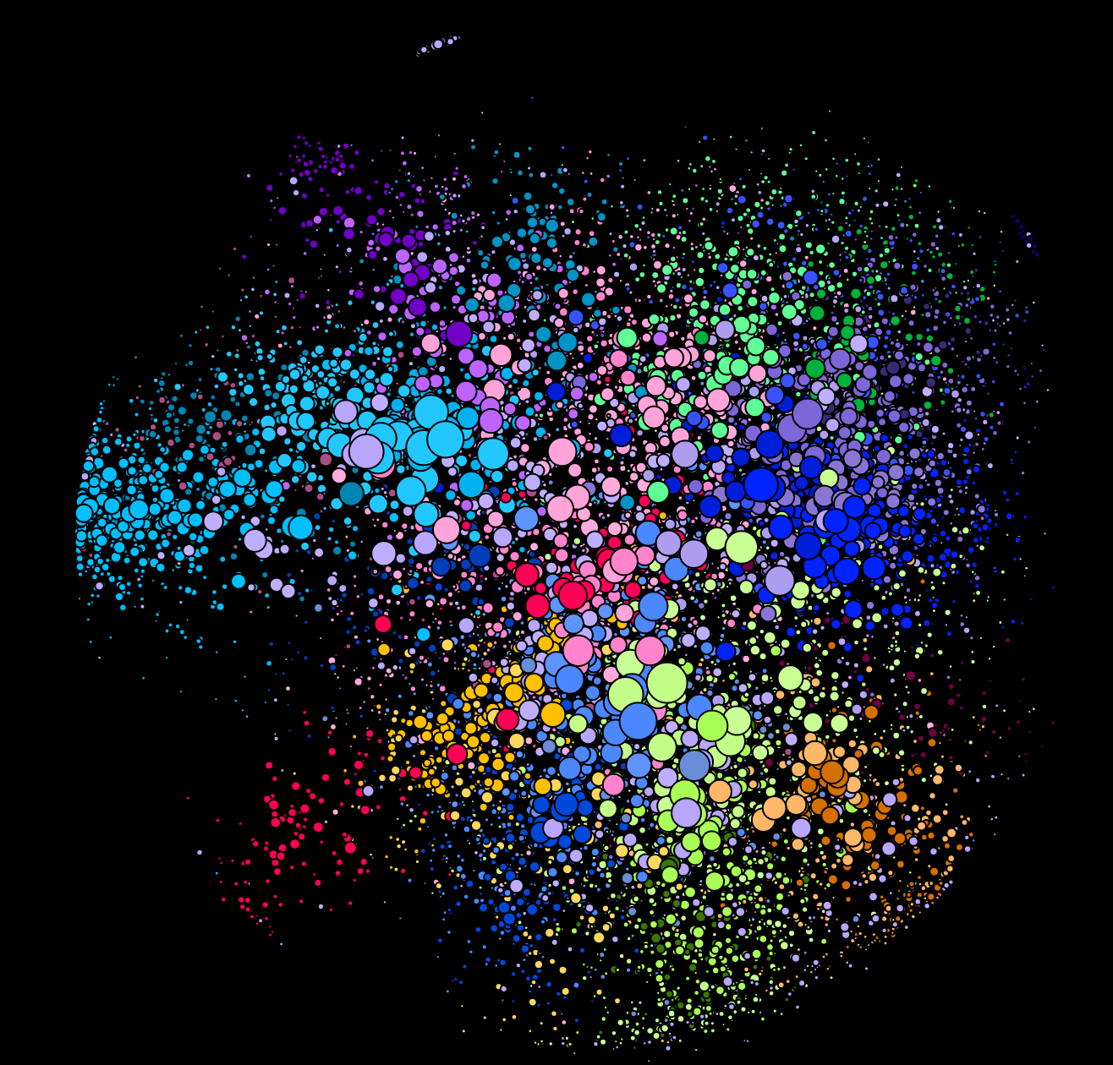
MOOn-Viz
A given visualization is described by two feature vectors:
Network features are intrinsic to the network
Readability features are visualization dependent

Slide 24
MOOn-Viz
Given a set of network features, what optimization of readability features is best*?
* Where ‘best’ is judged by user preference

Slide 25
MOOn-Viz
Given a set of network features, which optimization of readability features is best?
Network Features
Readability Features
2
Network Features
Readability Features
1
Network Features
Readability Features
3

Slide 26
MOOn-Viz
Train a genetic algorithm
Learn user preference on set of initial networks
Introduce variation (new networks)
Guess user preference based on existing data
Evolve through selection
Gather user preference data for new networks

Slide 27
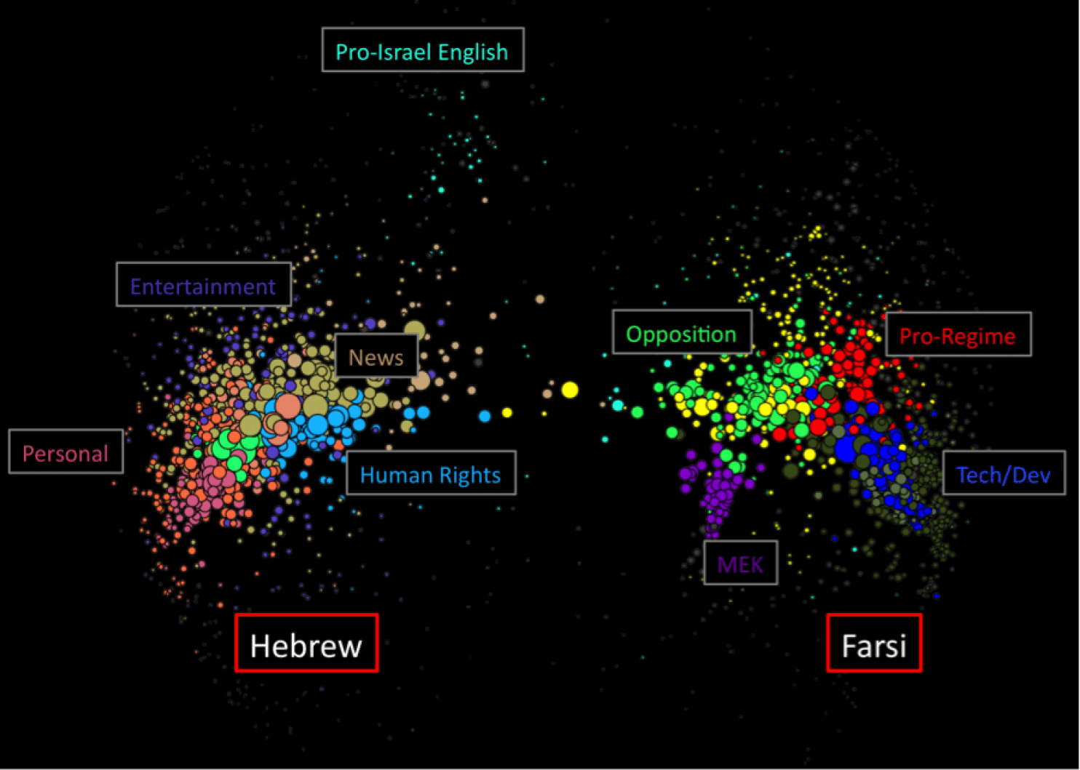
Graphika

Slide 28
Features

Slide 29
Graphika Requirement
There are many nodes in the network
Prominent nodes are easy to find
Clusters are easy to find

Slide 30
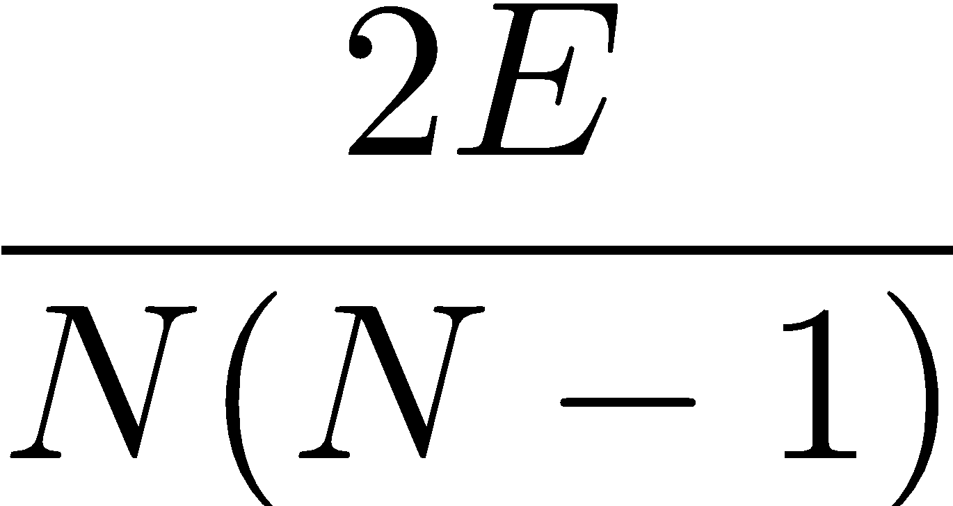
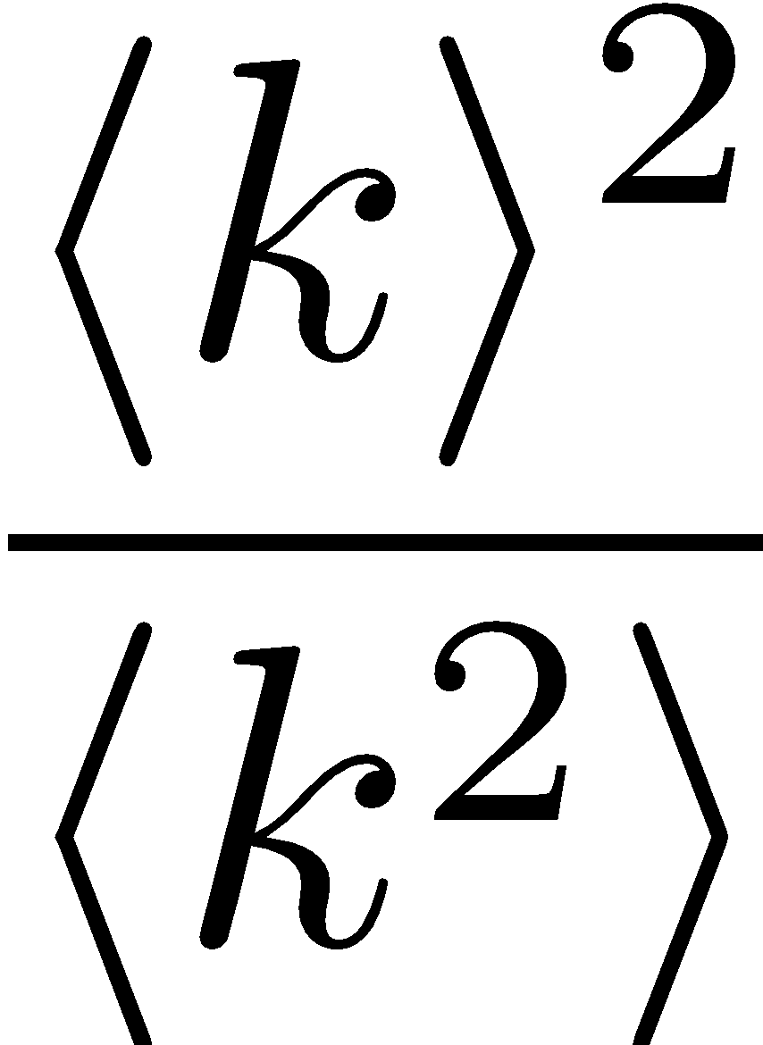
Network Features
Number of nodes
Network density
Number of clusters
Standard deviation of cluster size
Network heterogeneity

Slide 31
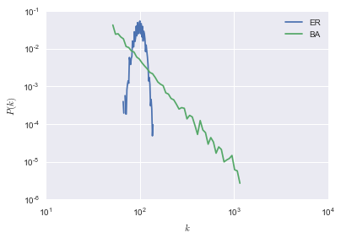
Network Features
Network heterogeneity
 | Erdos Renyi Graph | Barabasi Albert Graph
Network Heterogeneity | 0.9 | 0.5
Two graphs of the same size and similar average degree

Slide 32
Readability Features
Node overlap
Edge crossing
Cluster separation
Group overlap

Slide 33
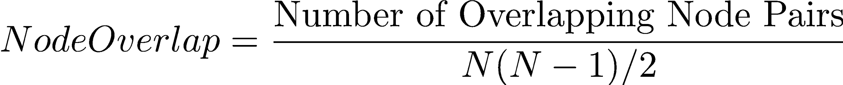
Readability Features
Node overlap

Slide 34
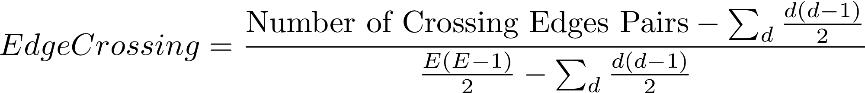
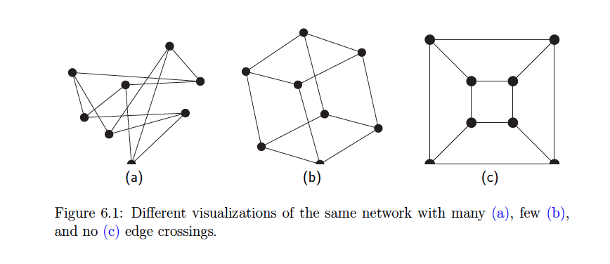
Readability Features
Edge crossing
Dunne et al. (2015)

Slide 35
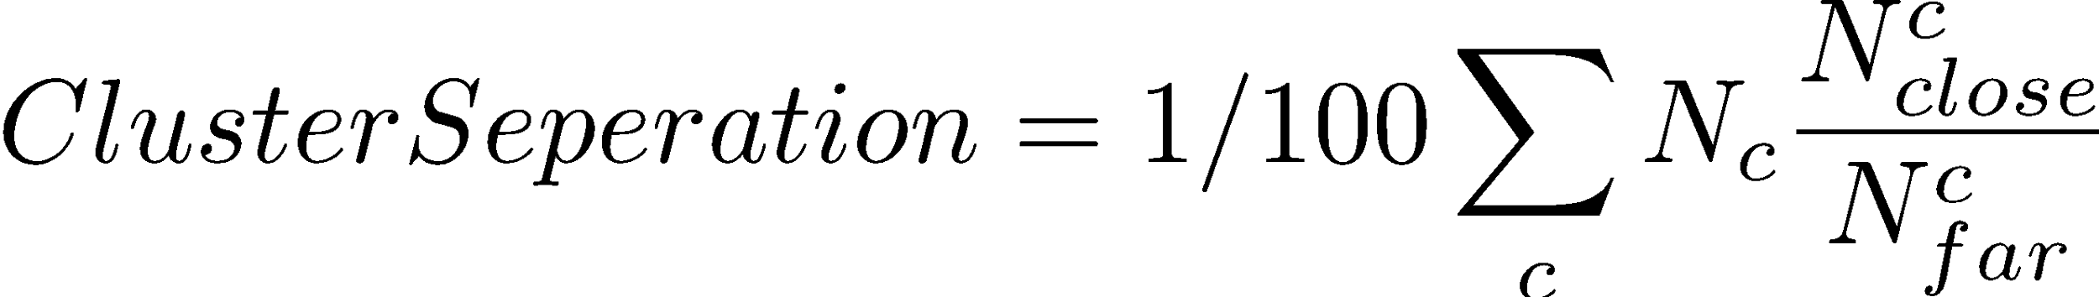
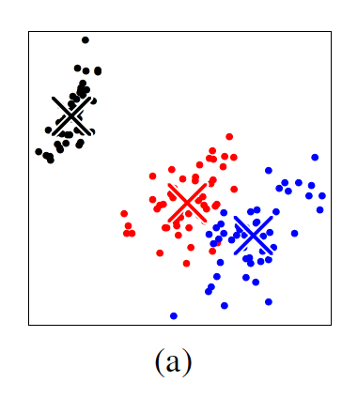
Readability Features
Cluster separation
Sedlmair (2012)

Slide 36
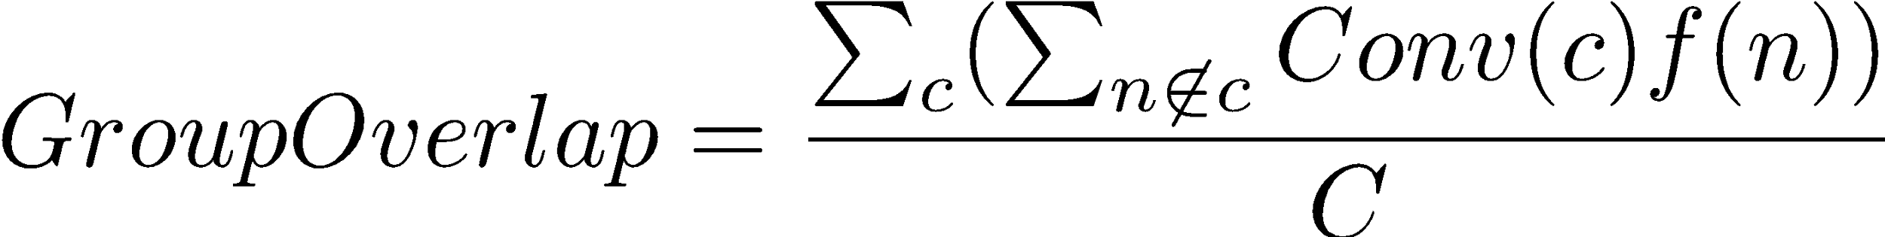
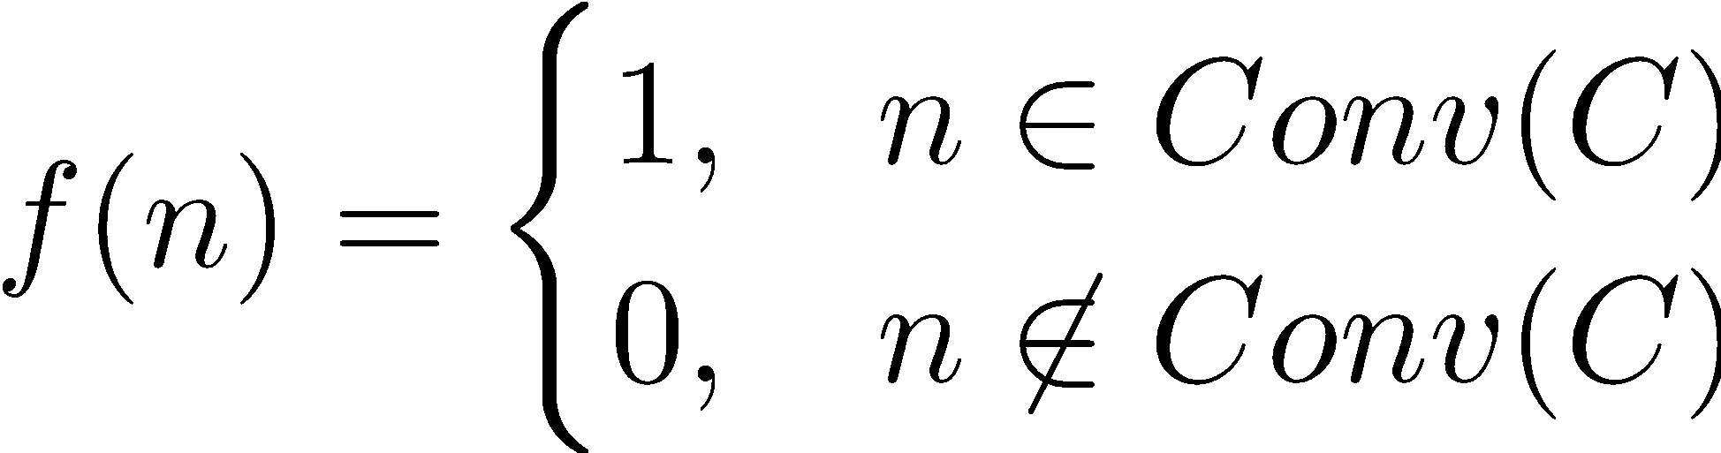
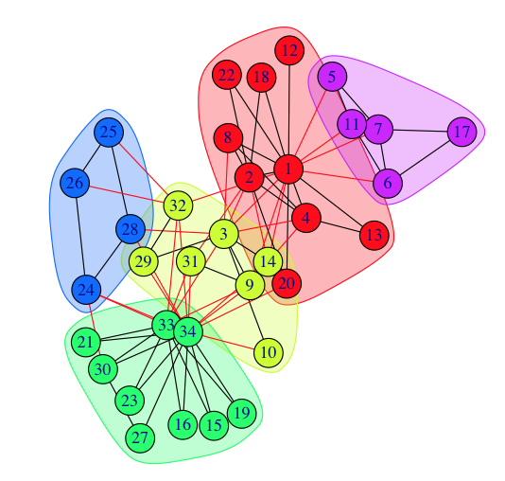
Readability Features
Group overlap
https://www.mathworks.com/matlabcentral/answers/263361-how-can-i-show-communities-from-the-image-adjacency-matrix

Slide 37
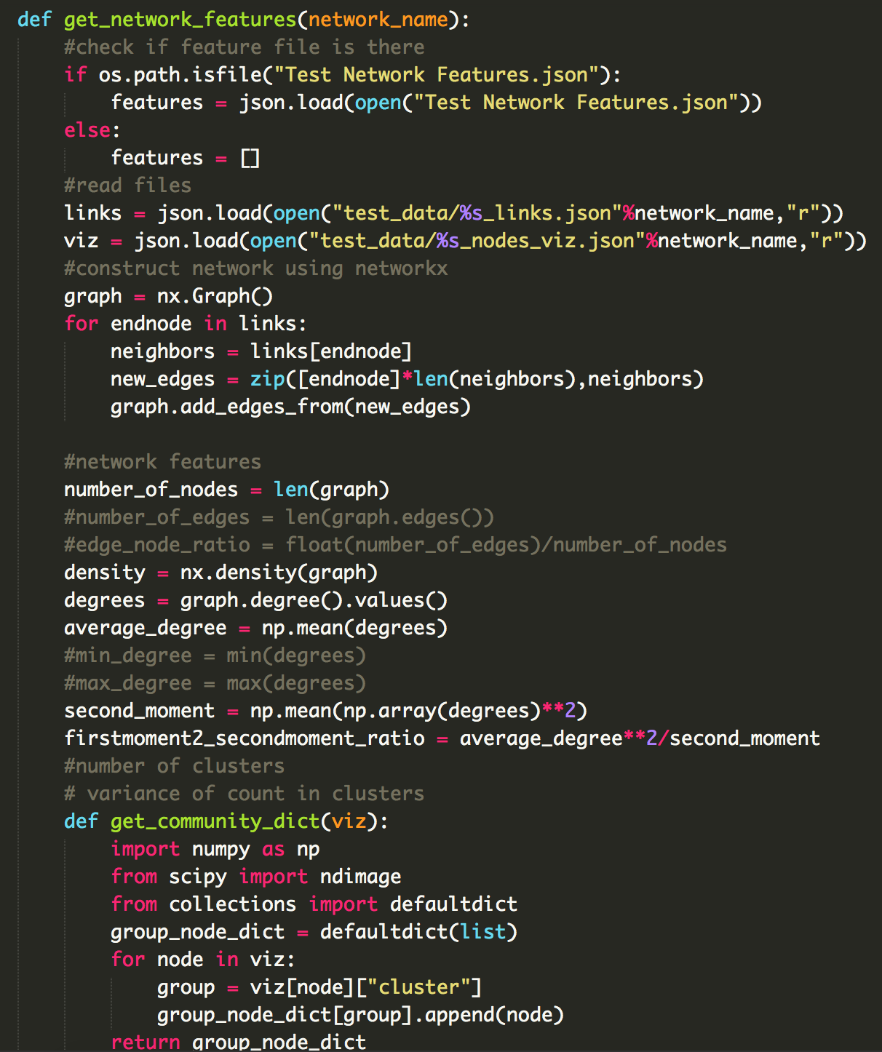
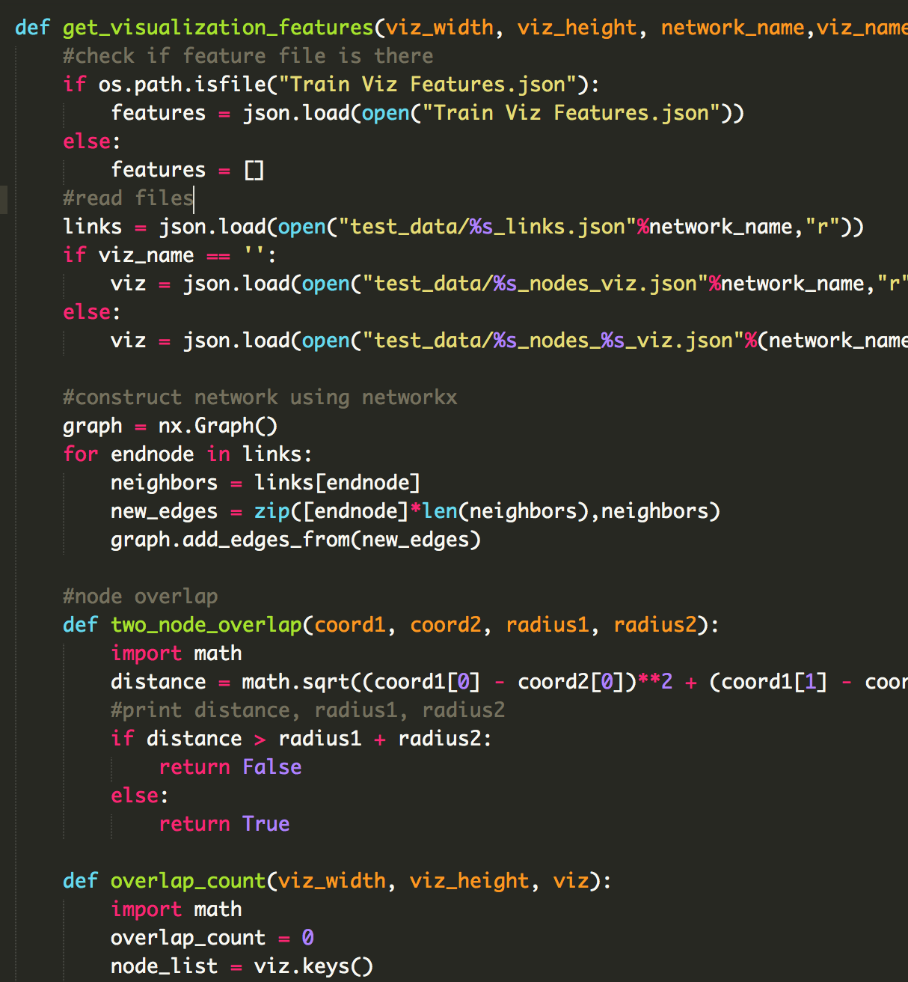
Features Implementations

Slide 38
Network Features
Network | 225 | 290 | 423 | 532
# Nodes | 11565 | 12049 | 11748 | 10958
Network Density | 0.021 | 0.020 | 0.029 | 0.006
# Clusters | 38 | 45 | 42 | 41
Std of cluster size | 308.31 | 480.20 | 143.38 | 151.11
Heterogeneity | 0.417 | 0.519 | 0.487 | 0.605

Slide 39
Feature Optimization
 | GRIP | PMDS | FM³ | FME | FMME
Node overlap | X | X |  |  | X
Edge crossing |  |  |  | X | X
Cluster separation |  | X |  | X
Group overlap |  | X | X | X

Slide 40
Genetic Learning Algorithm
Network Features
Readability Features
2
Train Dataset
Network Features
Readability Features
1
Network Features
Readability Features
3
…...
…...
…...
Test Data
Network Features
Network Features
Find the most similar network
Best Result
Readability Features

Slide 41
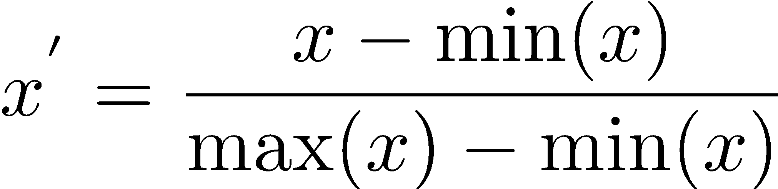
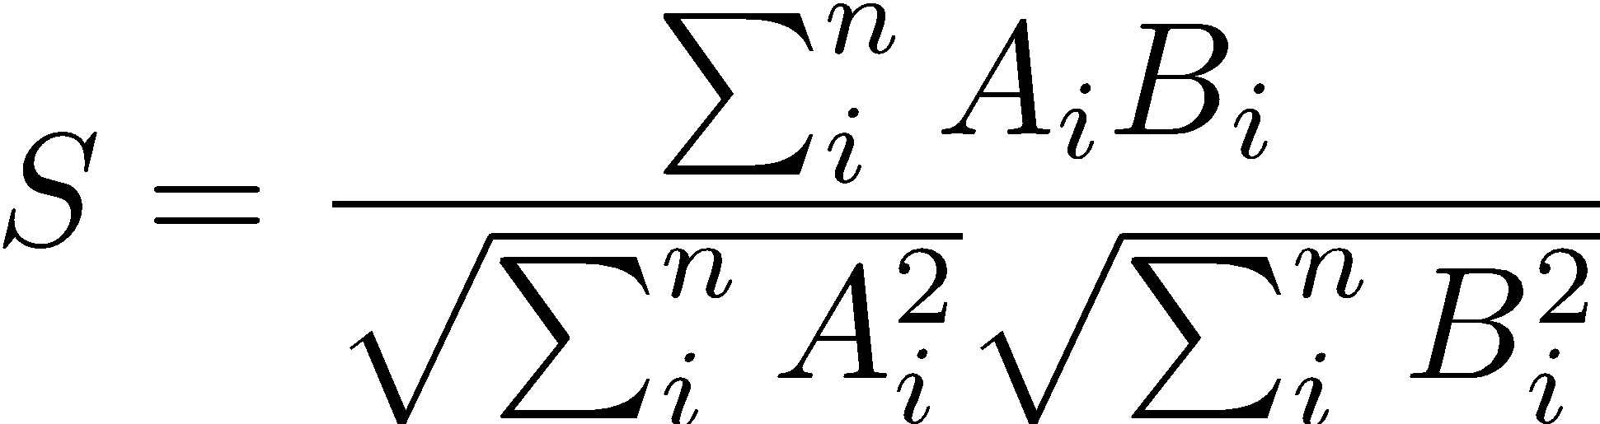
Genetic Learning Algorithm
Similarity calculation
Scale each feature in range [0,1] by using MinMax scaler
Calculating similarity based on cosine similarity

Slide 42
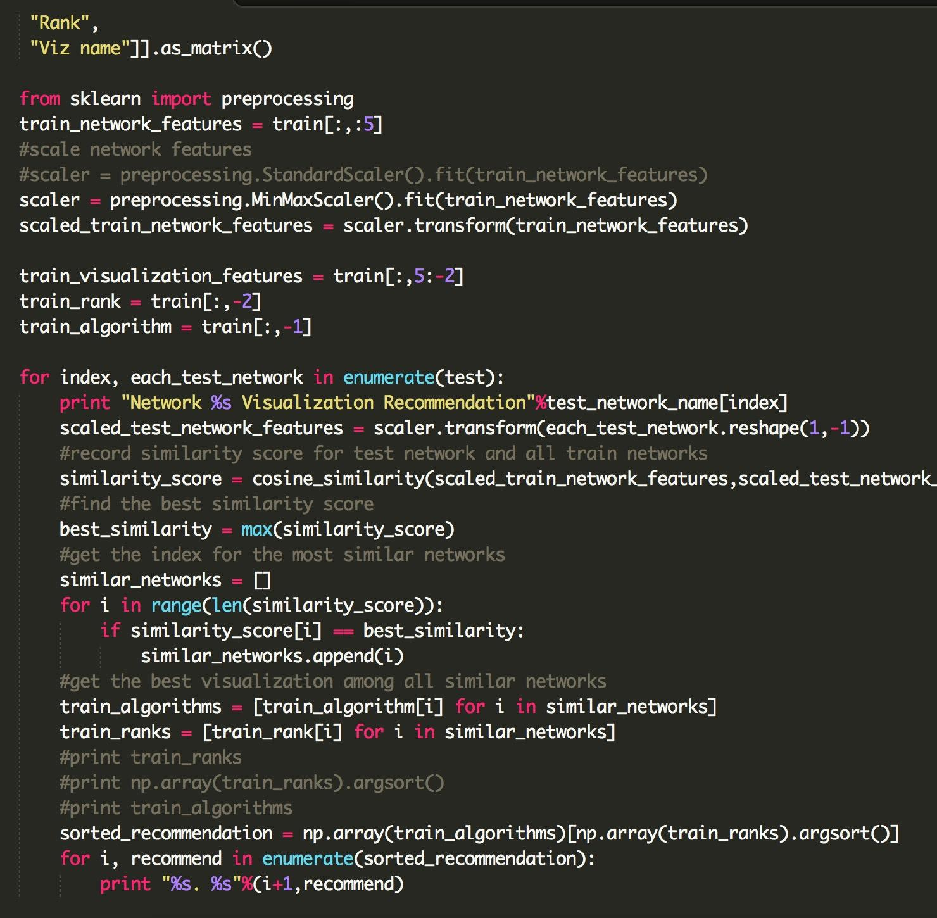
Genetic Learning Algorithm Implementation

Slide 43
Backend Implementation

Slide 44
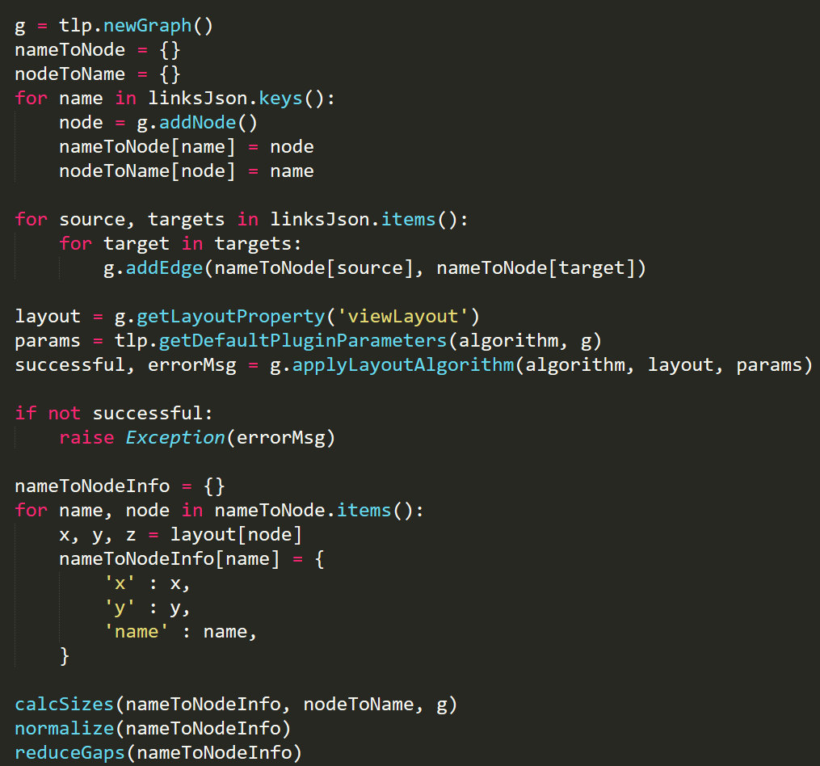
Implementation
Python backend
Layout algorithms in C++ using Tulip

Slide 45

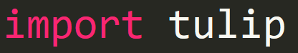
Why Tulip?
Fast - Written in C++
Straightforward Python library
Many different layout algorithms

Slide 46
Creating the Visualization
Calculate layout (e.g. FM^3, Pivot MDS, etc.)
Calculate node sizes
Reduce gaps between nodes
Roundify the layout

Slide 47
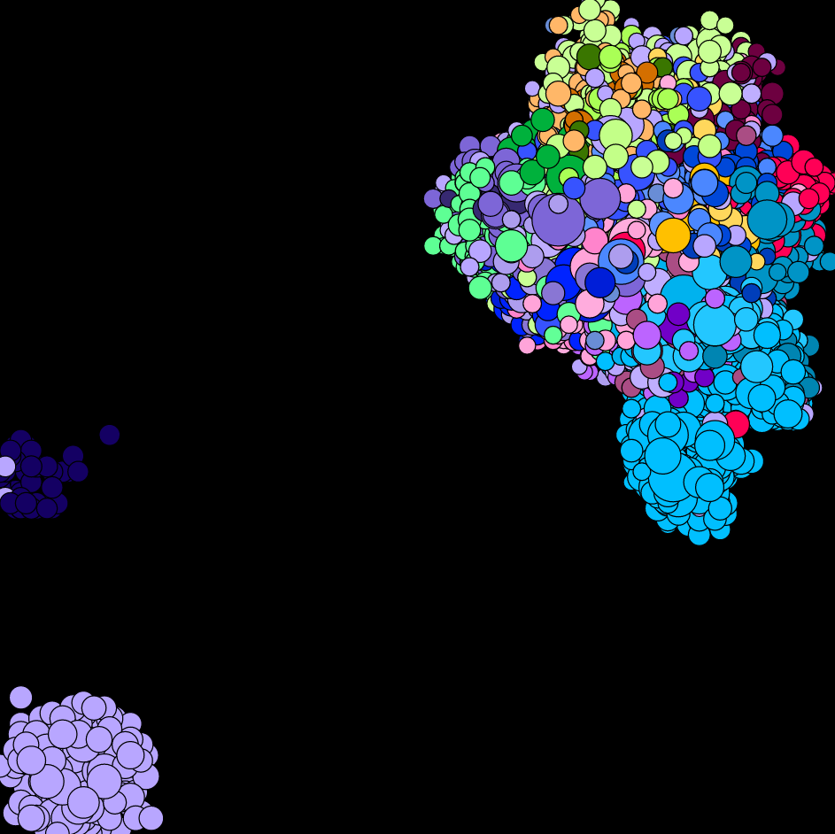
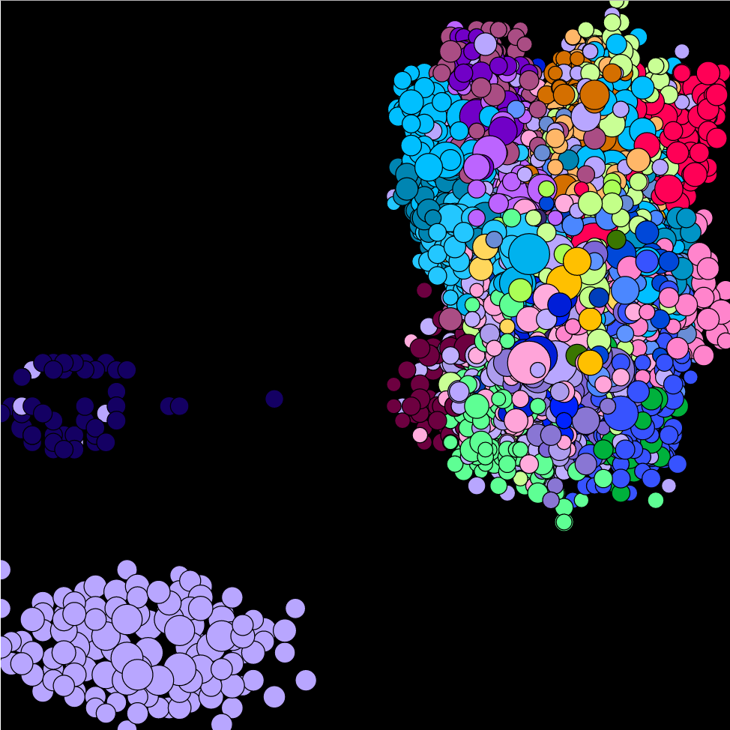
Reducing Gaps
Sort nodes by x-coordinate
Reduce large gaps between successive nodes
Repeat for y-coordinates

Slide 48
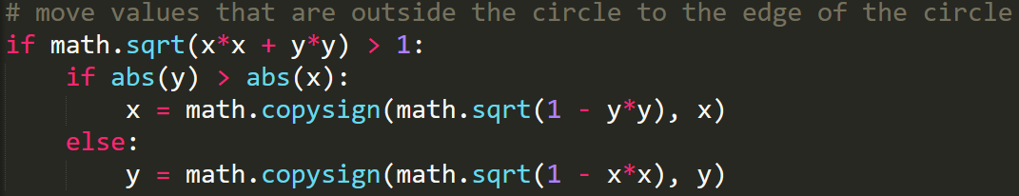
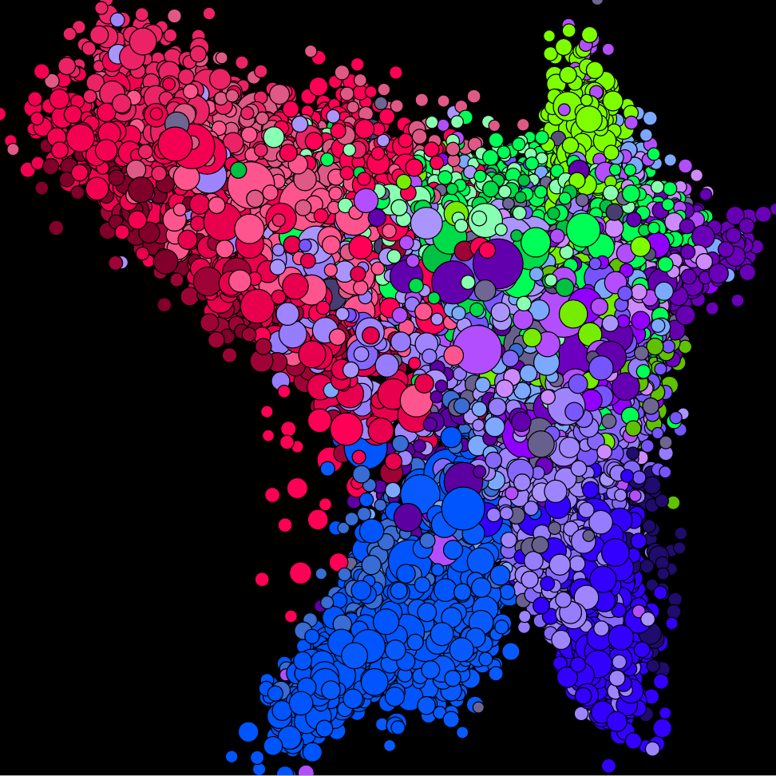
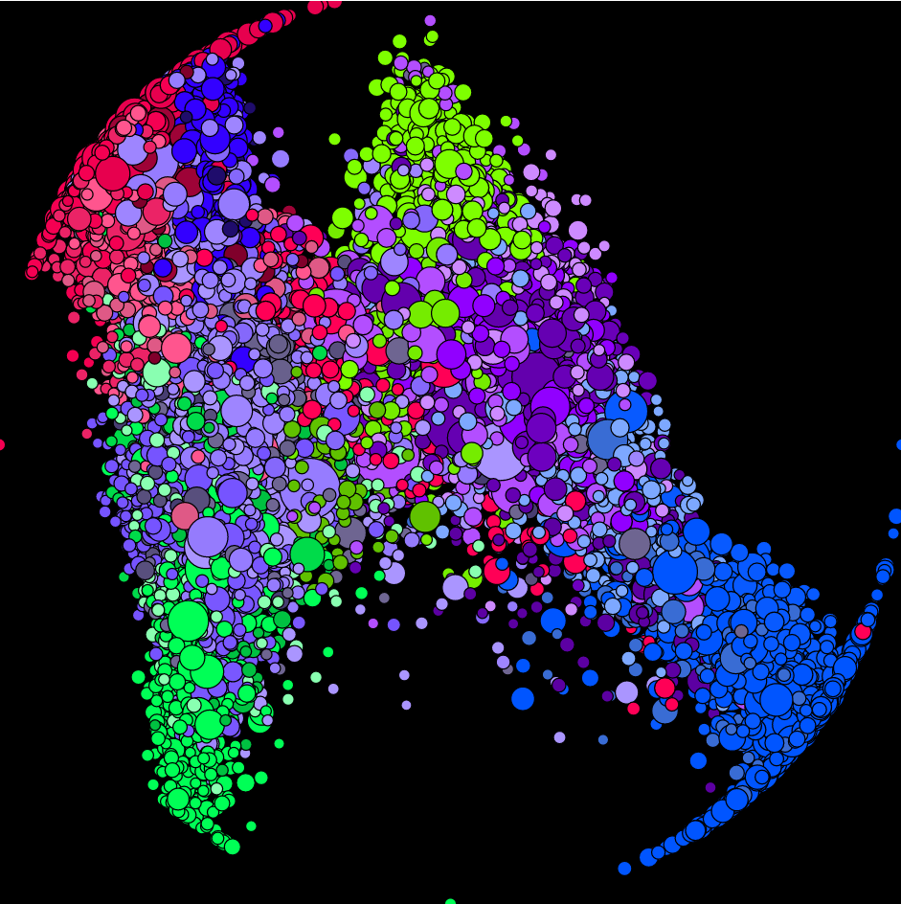
Roundifying The Layout

Slide 49
Layout Algorithms

Slide 50
GRIP
Coarsening phase: sequence of coarse graphs with decreasing sizes is computed
Refinement phase: successive drawings of finer graphs are computed
Gajer, Goodrich, and Kobourov (2000)

Slide 51
Pivot MultiDimensional Scaling
Select k “pivot” points
Construct an n × k matrix with the shortest-path distance from every node to selected k nodes
Use the first d eigenvectors to project into d-dimensional space
Brandes and Pich (2007)

Slide 52
FM³
Partitioning the nodes into disjoint subsets or ‘solar systems’
Collapse solar system into multilevel representation of the graph
Calculate force between solar systems with a multipole-based reduced quadtree
Hachul and Junger (2005)

Slide 53
Fast Multipole Embedder (FME)
Calculate force between nodes with a multipole-based reduced quadtree
Different attractive forces than FM³
Gronemann (2009)

Slide 54
Fast Multipole MultiLevel Embedder (FMME)
Modified version of FME
Includes multi-level approach of FM³
Tends to fill space better than FME
Gronemann (2009)

Slide 55
Learning User Preferences

Slide 56
Use Case
Issue Maps are commonly shared in news articles
Typical users may not be deeply familiar with network visualizations
Visualizations should be:
Visually appealing
Emphasize network structure

Slide 57
User Preference
We train user preference through Amazon Mechanical Turk (AMT)
Participants must have earned AMT’s ‘master’ rating for high quality work

Slide 58
User Preference
We recruited 33 participants
Each participant reviews 30 pairs of images
For each pair, participant selects image they find “more aesthetically pleasing”
We begin with 15 images total and each image is considered 4 times per participant

Slide 59
User Preference
Data from AMT study used to rank each network’s visualization options
Upload data through amazon s3 to get urls for each image
Pair up urls in csv file and upload csv to template on AMT
Extract and analyze data from result csv using machine learning program

Slide 60
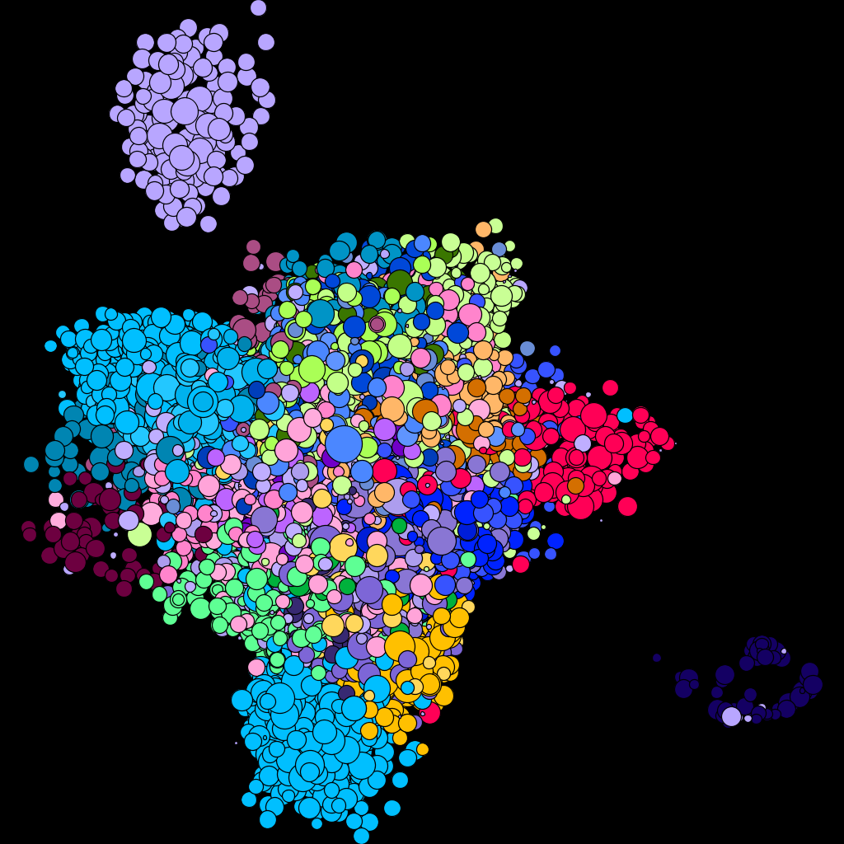
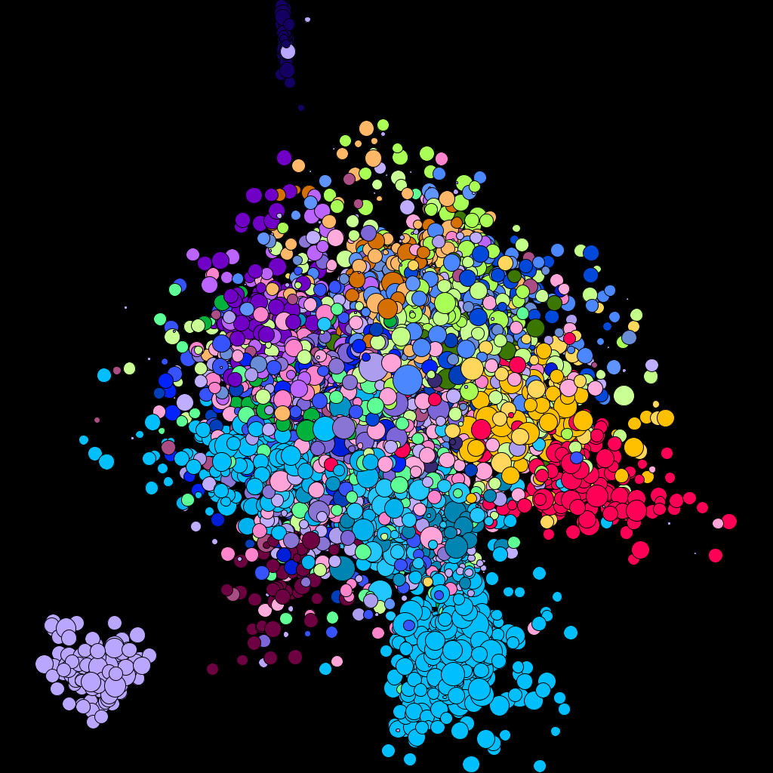
User Preference
WHICH IMAGE DO YOU FIND MORE AESTHETICALLY PLEASING?

Slide 61
User Interface

Slide 62
Thank you!

Slide 63
Purchase and Leonard (1996)
Minimizing edge crossings
Minimizing edge bends
Maximizing symmetry
Maximizing minimum angle between edges
Maximizing edge orthogonality
Maximizing node orthogonality
Maximizing consistent flow direction (directed graphs only)

Slide 64
Purchase and Leonard (1996)
Minimizing edge crossings
Minimizing edge bends
Maximizing symmetry
Maximizing minimum angle between edges
Maximizing edge orthogonality
Maximizing node orthogonality
Maximizing consistent flow direction (directed graphs only)

Slide 65
Dunne et al. (2015)
Node-node overlap
Edge crossing angle
Angular resolution
Group overlap
Visualization coverage

Slide 66
Dunne et al. (2015)
Node-node overlap
Edge crossing angle
Angular resolution
Group overlap
Visualization coverage

Slide 67
Sips et al. (2009)
Class consistency
“distance consistency...is correlated with people’s preferred views of a variety of real world data sets.”
Seldmair et al. find some error in centroid measure, but better than grid measure

